Slide 1
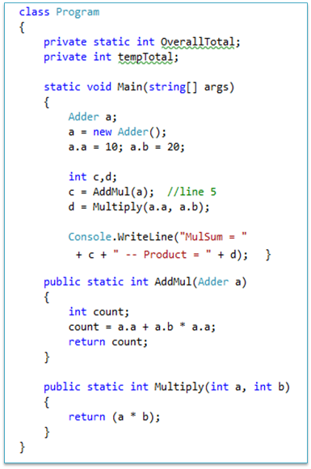
Big Picture of program execution
Source code
Main memory magnified for process 1
count
0x21
(Multiply)
b
a
(Multiply)
a
10
b
Code segment
(instructions)
count
20
d
c
Adder object (a)
(main)a
0x21
args
Stack Memory
Heap Memory
Main memory
Process 2
Process 1
. . .
. . . . . .
. .
processor
Process 3
compile
Byte code / IL
JIT compile
executable
Loader

Slide 2
How program executes?
Your source code is compiled to IL/byte code then converted into machine code.
The machine code (or executable) is loaded in the main memory by the loader
Executable loaded in the memory is called a process
Every process will have its own stack and heap memory to store data
Every instruction is executed one by one by the processor
Local Variables
All variables declared inside a function are called local variables (they include parameters, reference variables also)
Every local variable will occupy a memory space in the STACK memory (see the picture)
Scope: Local variables CANNOT be accessed outside of the declared function
A reference variable (though it is local) can hold the reference / address of an object that is created in the heap (note: Objects that you create using new operator will occupy space in the heap memory )
Lifetime: once the function execution ends the local variables die and the memory in stack is cleared.
Objects
Objects are created using new operator
Size of an object is equal to the sum of sizes of its members
Objects reside in heap memory
Lifetime: Every object dies either when the program ends or when there no references to the object (garbage collected)

Slide 3
C# Programming basics quiz…

Slide 4
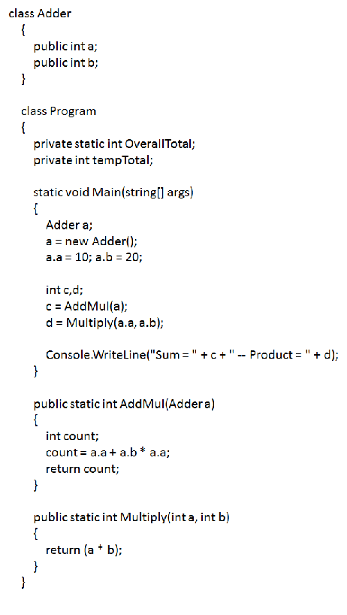
Question 1
How many constants are present in this code Snippet?

Slide 5
Question 1
How many constants are present in this code Snippet?
Ans: 4 constants
constants
Constants are literals whose value doesn’t change. E.g numbers, strings, characters (1, 2, “str”, ‘c’ etc.)

Slide 6
Question 2
How many local variables are present (defined) in this code snippet?

Slide 7
Question 2
How many local variables are present (defined) in the above code snippet?
Ans: 8
Local variables: variables that are DEFINED inside a function definition. Even function parameter variables are also local. Remember even reference variables, which are defined inside a function are local variables.
Note: See the red bullets above each local variable

Slide 8
Question 3
How many Instance variables are present (defined) in the above code snippet?

Slide 9
Question 3
How many Instance variables are present (defined) in the above code snippet?
Ans: 3
Instance variables: variables that are DEFINED inside a class but that are NOT static are called instance variables. They can be accessed only by creating an instance of that class, that is why they are called as instance variables.
Note: See the red bullets near each instance variable (also note that static int OverallTotal is NOT an instance variable, it is called as a class variable)

Slide 10
Question 4
How many Class variables are present (defined) in the above code snippet?

Slide 11
Question 4
How many Class variables are present (defined) in the above code snippet?
Ans: 1
Class variables: variables that are DEFINED inside a class as STATIC are called class variables. They can be accessed WITHOUT an instance of that class, using the name of the class.
Note: See the red bullet near each class variable (also note that tempTotal is NOT a class variable, it is called as a instance variable)

Slide 12
Question 5
What is the value of 'c' after circled code is executed?

Slide 13
Question 5
What is the value of 'c' after circled code is executed?
Ans: 210
This will evaluate as
a.a + (a.b * a.a)
Multiplication happens first
Operator Precedence: Every operator has a precedence in an expression, ie. When an expression is evaluated (calculated) + and – have less precedence than * and / , so in an expression * is evaluated first.
Note: expressions within parenthesis are evaluated first.
Read the complete precedence list of all operators.

Slide 14
Question 6
AddMul() invocation in main function is a …call by reference or call by value?

Slide 15
Question 6
AddMul() invocation in main function is a …
Ans: Call by reference
a is reference variable points to the object of the class Adder.
Call by Reference: If a function parameter is a reference variable (refers to an object), the function invocation is called “Call by Reference”.
Note: In Call by reference if the object value is changed in the function, it will reflect in the calling function..

Slide 16
Question 7
Multiply() invocation in main function is a …

Slide 17
Question 7
Multiply() invocation in main function is a …
Ans: Call by value
C and d are basic data types variables.
Call by Value: If a function parameter is of a basic data type or a value type variable like struct in .NET (basic datatypes like int, char, float etc., ), the function invocation is called “Call by value”.
Note: In Call by value if the parameter value is changed in the function, it will NOT reflect in the calling function..

Slide 18
Question 8
How many reference type variables are present in the code snippet?

Slide 19
Question 8
How many reference type variables are present in the code snippet?
Ans: 3
Reference type variables: If a variable is defined with a type that is a class name, it is called reference variable. It can hold a reference of an object of that class.
Note: Most of the non basic data type variables are reference types (if a variable is defined without int, float, char, double etc. it is a reference variable)
Note that variable for system class “string” is also a reference variable

Slide 20
Question 9
Can you access the variable 'count' in main() function?

Slide 21
Question 9
Can you access the variable 'count' in main() function?
Ans: NO
Scope of local variable: local variables can only be accessed within the function that is defined in. It cannot be accessed in other methods.
Note: Local variables are created when the function starts executing and dies when funcntion completes
Count is a local variable of AddMul() function. That CANNOT be accessed in other functions

Slide 22
Question 10
Can you access the variable 'tempTotal' in main() function?

Slide 23
Question 10
Can you access the variable 'tempTotal' in main() function?
Ans: Only when you create an object of Program
tempTotal is an instance variable. So, it cannot be accessed directly in main(), since main is a static function.
Scope of instance variable: instance variable CANNOT be accessed in a static method of the same class. But we can access the variable by creating an object of the same class inside that static function.
Note: static methods can access only static variables defined in the same class

Slide 24
Question 11
How many function declarations are available in the above code snippet?

Slide 25
Question 11
How many function declarations are available in the above code snippet?
Ans: 0
This code does not contain function declaration
Function Declaration: Function declaration just specifies the return type, function name and parameters, it will not contain function implementation.
Note: Generally you can find function declarations / prototypes in the interfaces.

Slide 26
Question 12
How many function definitions are available in the above code snippet?

Slide 27
Question 12
How many function definitions are available in the above code snippet?
Ans: 3
We have 3 function definitions in this code.
Function Definition: Function definition contains return type, function name, parameters and the function implementation.
Note: Implementation refers to the code inside the function, which you can see inside the flower braces.

Slide 28
Question 13
How many function invocations are available in the above code snippet?

Slide 29
Question 13
How many function invocations are available in the above code snippet?
Ans: 4
We have 4 function invocations in this code.
Function Invocation: Function invocation / function calling is the place where we call / invoke the function, it can be identified by function name, actual parameter and brackets.
Note: Console.WriteLine() is also a function invocation.

Slide 30
Question 14
How many local variables are present (defined) in the above code snippet?

Slide 31
Question 14
How many local variables are present (defined) in the above code snippet?
Ans: 8
All variables shown below bullets will be in stack memory
Stack memory: All local variables will be stored in the stack memory. Even the reference variables that are local will be in stack memory, but only the object it refers will be in heap memory
Note: Note that parameters and local reference variables are also stored in stack.

Slide 32
Question 14
How many objects of Adder class is created in heap memory in this code snippet?

Slide 33
Question 14
How many objects of Adder class is created in heap memory in this code snippet?
Ans: 1 - only in main function
Object referred by variable ‘a’ is stored in heap.
Heap memory: All objects that are created using new key word are stored in heap.
Note: Heap memory is dynamic memory, which can grow based on increase in usage.
This is the same object that is created in main()

